Slide 1
Introduction to microcontrollers
Experiment-4
Microprocessors
Microcontrollers

Slide 2
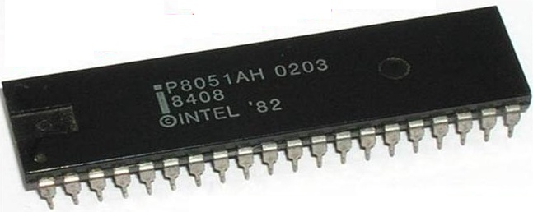
Microprocessors
Microprocessors run programs
Implicit characteristics:
Can read program stored in memory
Can understand instructions embedded within programs
Can interpret and execute these instructions
Carry out arithmetic and logic operations
Read input devices: keyboard/mouse…..
Send output: computer screen/printer……
Exchange information with external devices (network communication)

Slide 3
Computer program
Computer programs contain instructions
e.g. x = y + z;
Instructions contain operations and operands
Here ‘+’ is the operation,
And ‘y’ and ‘z’ are the operands
Many instructions read/write data(operands) from/to memory
(e.g. read y & z, and write back the value ‘x’)
Data is written to RAM
Data may be read from RAM or ROM

Slide 4
Microprocessor essentials
ROM having stored program
An instruction set (specific to μP)
Microcode which interprets the instruction code
An arithmetic and Logic unit to carry out instructions
A scratch pad(set of registers)
Hardware features to read from, and write to memory
Facility to interface with the external world
(Input and Output ports)
React to external events, stimuli
Count external events/generate delays
(timers and counters)
(Interrupts)

Slide 5
Microprocessor
Microprocessor
comprises of
CPU
ALU
Register file
I/O
Interrupts
Busses
CPU
ALU
BUS
I/O
Int

Slide 6
Microprocessor system
CPU
RAM
ROM
Interrupts
Peripherals
I/O ports
Timers
Counters
Serial port
CPU
RAM
ALU
BUS
ROM
I/O
Int
Peripherals

Slide 7
Microcontroller
Microcontrollers combine all
μp components in a single chip
CPU
RAM/ROM/Registers
I/O ports
Peripherals
Interrupts
CPU
ALU
Registers
I/O
RAM
Int
ROM
Peripherals

Slide 8
Microcontroller architecture
Memory
RAM
Flash ROM
I/O ports
Memory architecture
See link for detailed
8051 uC architecture
I/O
D0
CPU
I/O
D0
D1
D1
D2
D2
D3
ALU
D3
D4
D4
D5
D5
D6
D6
D7
D7
Registers
I/O
D0
I/O
D0
D1
UART
RAM
D1
D2
D2
D3
D3
D4
Int
ROM
D4
D5
D5
D6
Counter/timer
D6
D7
D7
http://www.met.iitb.ac.in/~nkk/NKK/8052_architecture.pdf

Slide 9
8051 microcontroller
8 bit ALU (works on 8 bit operands)
64K ROM, 256 byte RAM, 4x8 bit register files
Provides two external interrupts
I/O ports (parallel (4 x 8bit) and one serial (UART))
Three 16bit multifunction timers and counters
Arithmetic instructions (integer operands)+ , - , x , ÷
Logic instructions AND, OR, XOR, NOT, SHIFT, ROTATE
Memory Read/Write instructions
Code branching instructions
Ability to call and execute subroutines

Slide 10
More about registers and ports
Register or Memory
Parallel Port
CPU
0
1
2
3
4
5
6
7
D0
Registers are storage locations. In 8051 μC, registers store 8 binary bits organized as a byte
Data stored in RAM, ROM and Registers can be presented on any port
Bit position D0 is presented on port line ‘0’, D1 in port line ‘1’ and so on
Ports can be INPUT or OUTPUT
Register file
D1
D2
ALU
R0
D3
R1
D4
R3
D5
R0
D6
D7
D6
D5
D4
D3
D2
D1
D0
Rn
D7
I/O
RAM
Int
ROM
Peripherals

Slide 11
LEDs connected on P0 & P1
+5v
Ports are given an
Identity(P0,P1,P2..)
Each port has 8 pins
Each Pin has an
Identity(P0.1,P0.2...)
Observe LEDs on ports
Output High on a port
pin to light a LED
P89C51
7
6
5
4
3
2
1
0
P0.7
P
O
R
T
0
R35
LD8
P0.6
R34
LD7
P0.5
R33
LD6
P0.4
R32
LD5
P0.3
R31
LD4
P0.2
R30
P0.1
LD3
R29
LD2
P0.0
R28
LD1
Schematic diagram of the 8 LEDs connected to port 0

Slide 12
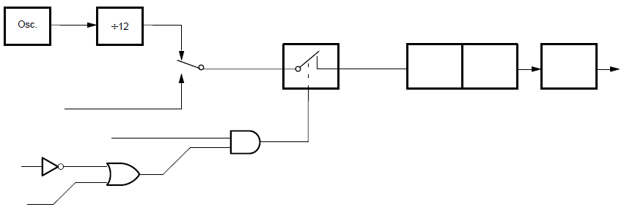
Timers and counters
8051 provides three 16 bit counters
Counters can be used to count pulses
Or generate precise delays
12MHz clock
÷ 12
1Mhz
C/T = 0
interrupt
TL1
8bits
TH1
8bits
TF1
C/T = 1
Control
T1 PIN
TR1
Timer 0/1 in mode-1
GATE
INT1

Slide 13
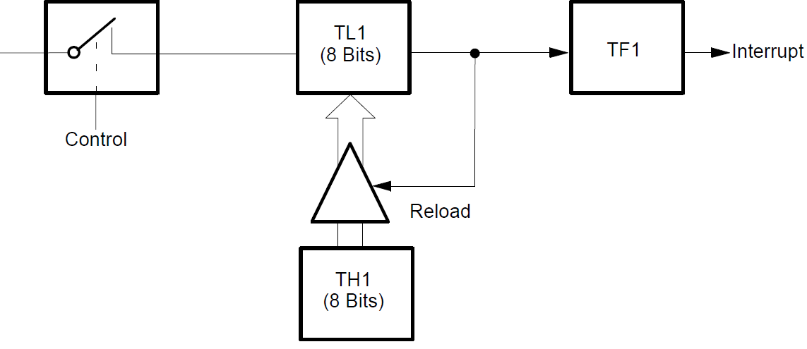
Timer 0/1 in Mode-2: Auto reload
Used to generate baud rate for serial communication

Slide 14
Memory architecture
64K
Four memory spaces
Special function
registers
64K Ext Data memory
64K program memory
256
128 byte ERAM
128 byte
SFR RAM
128
4/8K
128 byte IRAM
INTERNAL
0
0

Slide 15
Special function registers
Special function registers are used to configure peripherals.
Parallel I/O ports are mapped as SFR
Timer modes are configured through SFR
Serial port is operated through SFR
Interrupts are controlled through SFR
μC programming most often requires setting SFRs to configure and use peripheral devices

Slide 16
Examples of SFR
I/O Ports: P0, P1, P2 & P3
Timer mode set register: TMOD
Timer Control register: TCON
Timer-0/Timer-1 LSB register TL0/TL1
Timer-0/Timer-1 MSB register TM0/TM1
Accumulator/B register: ACC/B
Interrupt enable/priority register: IE/IP
Serial port registers: SCON, SBUF
Program status register: PSW
Data pointer registers: DPH/DPL

Slide 17
More on SFRs
SFR are 8 bit registers
Some 8 bit SFRs also have bit significance
TCON
PORT-2
P2.7
P2.6
P2.5
P2.4
P2.3
P2.2
P2.1
P2.0

Slide 18
Interrupts
μC reacts to external world through
Polling I/O lines
Interrupts (μC may have multiple interrupts)
Interrupts initiate Interrupt Service Routines
Interrupts can be external to μC or generated by internal events such as ‘timer overflow’
Interrupts are associated with priority and vector addresses
Concurrent interrupts are resolved through an interrupt priority mechanism

Slide 19
More on ports
All 8051 ports can be used for input or output
A port pin can be made Low or high
Low value is signalled by logic level =0 , usually Voltages below 0.4V
High value is signalled by logic level=1 (voltage >2.4V)
All port pins can be read (like reading from memory)
To read logic status of a port pin, Logic level ‘1’ first, logic ‘1’ has to be outputted on that Pin
E.g. to read port P1 pins, two steps are needed.
P1 ← 0xFF
Register R0 ← P1

Slide 20
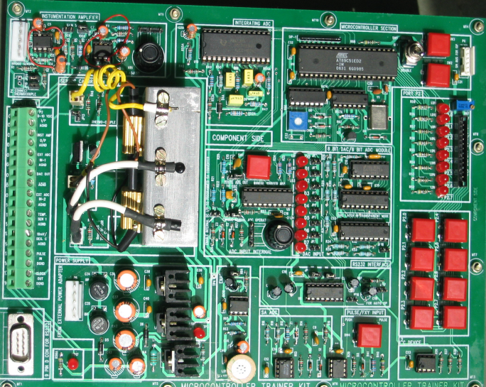
Using the microprocessor Kit
ADC
microcontroller
Thermocouple amplifier
Port P0
I/O port
Temperature sensors
Port P2
As out put
DAC
Port P2
As input
Serial port

Slide 21
Using microcontroller kit
Using the Keil IDE to write C-code and cross-compile it.
Compiled code can be tested on PC by using Keil debugger
Download compiled code(Intel-hex format) to microcontroller by employing serial loading feature
Run code on target CPU and debug errors

Slide 22
Experiment-4
Using an IDE and cross compiler
Writing a C program
Compiling
Downloading
Run & Debug
Understanding special function registers {SFR}
Using microcontroller ports {Architecture}
Using microcontroller timer {Architecture}

Slide 23
Structure of μC C-code
Describe briefly, what the program does or achieves in the header.
/***************************************/ .. …Comments
#include <reg52.h> /* Typical include files in C language */
#define ………. /* include your define statements here */
sbit …… /*include your SFR bit definitions here */
int…. /* include global variable definitions here */
char ….
Void func1 () /* include your functions here/*
{
}
void main () /* main code */
{
/* include your comments in the main program*/
}

Slide 24
Using the IDE and cross compiler
Run the IDE (Keil software)
Create the Code as .C file through Keil IDE
Create a project in Keil IDE
Associate your .C file with the project
Add a mandatory ‘startup code’ file
Compile the C code into
Run compiled code in the debugger provided by Keil IDE
Debugger provides dummy ports to check and confirm port operations

Slide 25
Experiment-4.1
Assign a value to Port 2 in your program, execute the program and observe the value on Port 2 LEDs.
Code>
#include <REG52.H> /* special function register declarations */
/* for the intended 8051 derivative */
#include <stdio.h> /* prototype declarations for I/O functions */
void main (void)
{
while(1) //End less while so that program never ends
{
P2 = 0x55;
}
}

Slide 26
Experiment-4.3
Give input at port 0 using jumpers J2 to J9. Write a program to assign this value to Port 2
Note: A connected jumper assigns bit value ‘1’ to the micro-controller pin.
Solution:
#include <REG52.H>
#include <stdio.h>
void main (void)
{ P0=0xFF; //assigns bit value ‘1’ to the micro-controller pin.
//0xFF or 1111111 or 255
while(1) //End less while so that program never ends
{ P2 = ~P0;} //inverter (~)
} }

Slide 27
Timer delays: generating delay of 1ms
Initialize Port 2 with the value 00h.
After a delay of 1 ms assign Port 2 the value FFhex.
After a delay of 1 ms assign Port 2 the value 00hex.
Run step 2 and step 3 in an infinite loop.
This should generate a square wave on the pins of Port 2.
For generating the delay you need to use a timer.
What is the frequency?

Slide 28
Delay generated by software
#include <REG52.H>
#include <stdio.h>
void softwaredelay (unsigned int x)
{
unsigned char d;
while(x-->0)
{
for (d=0;d<110;d++) {;}
}
}
void main (void)
{
//Initialize Port 2 with value 00h. P2=0x00;
while(1)
{ P2=0xFF;
softwaredelay(1);
P2=0x00;
softwaredelay(1);
}
}

Slide 29

Delay generated by hardware
TMOD
0 0 0 1
11.0592Mhz
÷ 12
0.922Mhz
C/T = 0
interrupt
TL1
8bits
TH1
8bits
TF1
C/T = 1
Control
T1 PIN
Starting count= 64614
Hex of 64614 = 0xFC66
TR1
GATE
65535-64614=921
921 x 1.085x10⁻⁶ = 999.3μSec
INT1

Slide 30
Delay generated by hardware
#include <REG52.H>
#include <stdio.h>
//delay using Timer0
void hardwaredelay(void)
{
TMOD = 0x01; //timer0 in mode0
//values for 1msec = 0xFC66
TL0 = 0x66;
TH0 = 0xFC;
TR0 = 1; //start timer
while(TF0==0)
{;}
TR0 = 0; //stop timer
TF0 = 0;
}
void main (void)
{
P2=0x00; //Initialize Port 2 with the value 00h.
while(1)
{
P2=0xFF;
hardwaredelay();
P2=0x00;
hardwaredelay();
}
}

Slide 31
Some interesting programs
Students are advised to write code to
Generate a running border on P0 and P2
Running border from P0 → P2 → P0 →
Understand how to use output data to DAC and create audio output of known frequency through onboard speaker
Port P0
Port P2

Slide 32
Read experiment-4 laboratory manual
and other associated files on moodle

